Slide 1
27.
04.
26
Main Events
FED MEETING
In the last meeting chaired by Powell, the Fed is expected to continue buying time
EU CPI
April inflation data will likely determine the outcome of the ECB meeting scheduled for later the same day
ECB MEETING
The European Central Bank is expected to hint at a possible hike in the near future
US NON-FARM PAYROLLS
A strengthening labor market could cement expectations that the Fed will not cut rates this year
29.04
30.04
30.04
08.05
The AI Value Shift: Navigating Scarcity, Software Squeeze, and Global Bifurcation
The semiconductor ecosystem, particularly high-performance memory, remains the most attractive area for capital as structural supply bottlenecks and the AI feedback loop support high revenue visibility and margin resilience.
While the software sector has already undergone significant valuation de-rating, it remains at risk of a fundamental structural shift as AI-enabled in-house development threatens the long-term revenue growth of traditional vendors.
China’s coordinated humanoid robotics initiative represents a critical long-term thematic play, leveraging government-backed data collection centers to automate industrial production and sustain growth despite demographic headwinds.
In financial markets, one of the most hotly debated topics in recent years has been artificial intelligence, with conflicting views on whether the market has been overly optimistic in assessing the prospects of stocks linked to the development of this new technology, as well as on its impact on existing business models and employment.
Following several recent sector conferences with leading technology companies, the key takeaways are clear and worth highlighting.
Demand for both advanced logic and high-performance memory continues to exceed supply, supported by a positive feedback loop: better AI systems drive more usage, which in turn drives further demand for computing power and memory. This is particularly supportive for the entire semiconductor sector, as demand for AI-related semiconductors is expected to exceed available capacity for years. Increasing production capacity takes time and is constrained by the complexity of manufacturing and the pace at which new facilities can be built.
This keeps the balance between demand and supply tight and supports a favorable environment for chip producers, supporting strong revenue visibility, resilient margins, and sustained earnings growth across key parts of the semiconductor ecosystem.

Slide 2
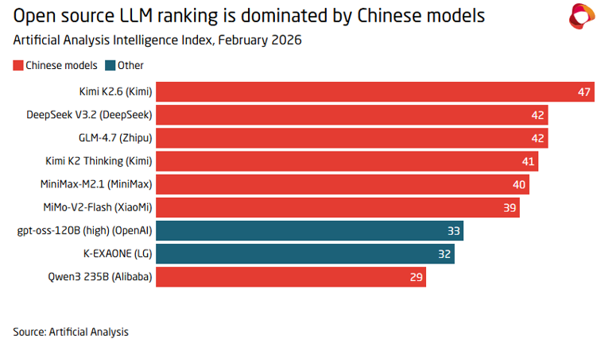
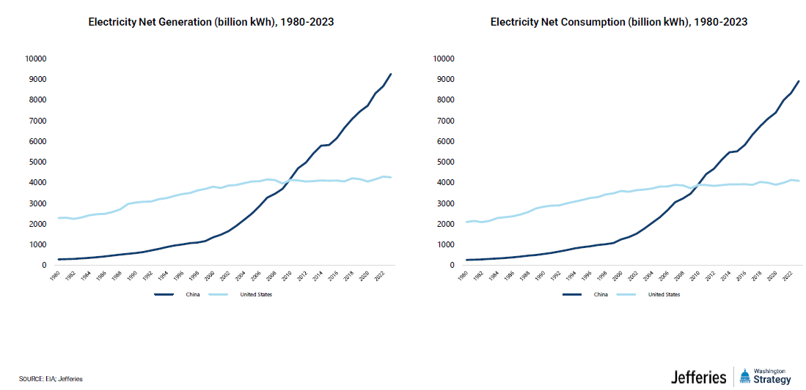
(continued)
Even memory—long considered the most cyclical component—is now being seen as benefiting from structural demand, thanks to the increasing workloads associated with artificial intelligence. Scarcity in semiconductors is no longer a bottleneck — it is becoming the organizing principle of the AI economy.
Artificial Intelligence is not just adding demand to the system, it is reallocating it, causing the crowding out of some industries. The share of memory allocated to smartphones has declined significantly, reflecting a structural shift in demand toward AI infrastructure: Smartphones and PCs are no longer the main drivers of growth for semiconductors. As capacity is increasingly directed towards artificial intelligence, traditional consumer electronics are being squeezed. For example, companies such as Xiaomi have highlighted growing difficulty in securing key memory components, alongside rising costs. Crucially, they see little prospect of relief for at least a year—if not longer—suggesting these pressures may persist longer than many expect. This dynamic is putting pressure on lower-end and mid-tier device manufacturers, while reinforcing the competitive position of premium players.
While semiconductors are the main beneficiaries of the development of artificial intelligence, software sits at the opposite end of the spectrum. Advances in AI are enabling large companies in other sectors to develop internally what previously was sourced externally. The more powerful AI models become—such as those of Anthropic and OpenAI —the more companies will be able to develop in-house the code and software they need, reducing demand for software companies. Over time, this raises questions about how much value will accrue to traditional software vendors, particularly if enterprises increasingly choose to build rather than buy. This could jeopardize the earnings and revenue growth of these companies, as well as put pressure on their margins. The trends observed recently in the market thus appear to be perfectly rational.
Another notable trend worth pointing out is that the AI world is splitting into two separate tracks. Because of security concerns and politics, the US and China are building their own independent systems instead of sharing one global platform. In the US, the goal is Super Intelligence. Leading companies like OpenAI (ChatGPT), Google (Gemini), and Anthropic are racing to build the smartest "brains" possible, focusing on high-level reasoning and premium performance.
While in the United States the focus is on excellence and pushing the boundaries of technology, in China the approach is more pragmatic: the emphasis is on developing low-cost, open-source models that can be used on a large scale by all companies. In China, by contrast, the focus is on enabling faster and broader adoption of new technologies to streamline processes and reduce costs. Companies like Kimi and MiniMax are building highly efficient systems that are much cheaper to run.
With China and the United States emerging as the only two countries at the forefront of AI, other regions are left with the choice to align with one of two distinct technological frameworks. Given geopolitical issues, the AI economy is not globalizing—it is bifurcating. Convergence appears unlikely: a Western company is unlikely to adopt Chinese AI, and vice versa. At the same time, a new constraint is becoming more visible: energy. Running AI systems requires large amounts of electricity, and this is becoming an increasingly important factor in determining how fast AI can scale. In this context, China is working to turn its strength in energy production and infrastructure into a competitive advantage. Lower electricity costs and faster deployment of power infrastructure allow it to expand AI capacity more efficiently.
Source: Artificial Analysis Source: Jefferies

Slide 3
(continued)
As AI continues to expand, new applications are starting to emerge beyond software and chips. One of the most compelling new themes is humanoid robotics, particularly in China. What is notable is not just the technology itself, but the coordinated ecosystem being built around it. Government support is playing a critical role, with local authorities actively encouraging deployment and, in some cases, acting as early buyers to accelerate adoption. With declining birth rates and a shrinking workforce, automation is becoming a necessity rather than a choice.
In China, the government is directly buying robots and placing them in large "data collection" centers. These are facilities where robots are trained in real-world conditions to perform simple tasks such as moving objects, sorting goods, checking quality, or basic factory work. Humans are involved at the beginning, showing the robots how to do these tasks, while all the data generated is collected and used to improve their performance over time. This creates a simple but powerful cycle: the more robots are used, the more data they generate, and the better they become. Over time, this allows robots to replace a portion of human labor in repetitive tasks. They operate around the clock, require no breaks, and deliver consistent results, making them very attractive for factories. For China, the objective is clear: offset labour constraints and sustain economic expansion despite demographic pressure. However, large-scale deployment will take at least five years.
Overall, the AI cycle remains strong, but where value is created is changing. Today, the most attractive areas are those with clear bottlenecks, such as semiconductors and energy infrastructure. In contrast, parts of the software sector face increasing pressure from AI itself, which could limit growth and margins. This makes positioning more important than ever.
I

Slide 4

Asset Allocation View
Equity
Developed Markets
Emerging Markets
Fixed Income
Developed Markets Sovereign
Developed Markets Corporate
Emerging Markets
Commodities
Currencies | Commentary below
Equity
UNDER
NEUTRAL
OVER
Developed Markets
We maintained the Neutral recommendation on Developed Market equities. Equity markets continue to stand out as the asset class with the brightest outlook. The strong results expected for this earnings season, the start of Warsh’s tenure as Fed chair, the apparent easing of tensions in the Middle East, the meeting between Trump and Xi in mid-May that could smooth out some friction between the two countries, and a global growth that continues to show resiliency are all supportive factors for equity markets. The main short-term vulnerabilities are still linked to the situation in Iran—particularly a prolonged closure of the Strait of Hormuz—and a physiological retracement following the sharp rally of recent weeks. Among developed countries, Europe is viewed as the region toward which the committee harbors the greatest caution
UNDER
NEUTRAL
OVER
US |  | Europe |  | Japan
Emerging Markets
We kept our Neutral stance on Emerging Market equities. The same considerations outlined above for developed markets apply to emerging markets, which additionally trade at lower valuations, enhancing their relative attractiveness. Many of these markets also possess substantial reserves and are net exporters of commodities, positioning them to benefit from the ongoing rise in commodity prices. Finally, emerging markets are seen as having the greatest rebound potential should the conflict subside and the Strait of Hormuz reopen, particularly in Asia, as the region most dependent on imports passing through that chokepoint.
UNDER
NEUTRAL
OVER
Asia ex-Japan |  |  | EEMEA |  |  | LATAM

Slide 5
Fixed Income
Developed Markets Sovereign
We have kept our Neutral recommendation on Developed Market sovereign bonds. The committee expects that the recent surge in commodity prices may shift inflation expectations among both consumers and policymakers. The major central bank meetings scheduled for this week will help clarify the extent to which monetary policy tightening is a genuine risk. In the short term, rates are expected to remain range-bound, with limited room to fall from current levels.
UNDER
NEUTRAL
OVER
EU Core |  |  | EU Periphery |  |  | US Treasury |  |  | Japanese JGB
Developed Markets Corporate
We maintained our Neutral recommendation on Developed Market corporate bonds. Global growth continues to hold up relatively well, and demand for bonds remains strong, underpinned by ample liquidity, with new issues oversubscribed in the primary market and spreads narrowing once again in the secondary market. That said, although spreads are somewhat wider than the multi-year lows reached shortly before the conflict, they do not yet sufficiently compensate for the riskier environment. Within credit, investment-grade bonds remain our preferred allocation over high-yield.
UNDER
NEUTRAL
OVER
IG Europe |  | IG US |  | HY Europe |  | HY US
Emerging Markets
We have kept our Neutral recommendation on Emerging Markets Debt. The reasons are the same as those just outlined for developed countries' corporate bonds.
UNDER
NEUTRAL
OVER
Local Currency |  | Hard Currency IG |  | Hard Currency HY
Commodities
Our recommendation for commodities remains Neutral. We have become more cautious (neutral) on precious metals, in light of recent sales by central banks and the possibility that some investors who bought precious metals over the past year because of their significant outperformance relative to other asset classes may liquidate part of these positions and shift back into technology stocks, which have been rising steadily for several weeks now. In the medium to long term, however, we remain positive. Given the growing competition for essential raw materials, we are turning more optimistic on industrial metals.
UNDER
NEUTRAL
OVER
Precious |  |  | Energy |  |  | Industrial |  | Agricultural

Slide 6
Currencies
We maintained our Neutral recommendation on the US Dollar. We are maintaining a neutral stance, waiting to see the stance taken by the various central banks at their meetings this week
The view on the Euro remains Neutral as well for the same reason.
We have maintained our recommendation on the Chinese Renminbi to Neutral with a bullish bias.
The outlook for other emerging markets currencies has been confirmed as Neutral with a bullish bias, with a preference for currencies of countries that are net exporters of energy commodities.
Euro |  |  | USD |  |  | CNY |  |  | Other EM
The information contained herein is confidential and proprietary and intended only for use by the recipient. The materials may not be reproduced, distributed or used for any other purposes. The information contained herein is not complete and does not contain certain material information about the investments described in the present document, including important disclosures and risk factors associated with these investments, and is subject to change without notice. This document is not intended to be, nor should it be construed or used as, an offer to sell, or a solicitation of any offer to buy, shares or limited partner interests in any funds managed by Azimut Investments S.A. If any offer is made, it shall be pursuant to a definitive Prospectus / Private Placement Memorandum/Offering Memorandum prepared by or on behalf of a specific fund which contains detailed information concerning the investment terms and the risks, fees and expenses associated with an investment in that fund.
In addition, the market trend information herein has been prepared by or on behalf of Azimut Investments S.A. and has not been independently audited or verified. Investment returns may vary materially from the stated objectives and/or targets so that investors may have a gain or a loss when they redeem their investment. As with any investment (vehicle), past performance cannot assure any level of future results. Forward looking statements constitute the opinion of Azimut Investments S.A. does not guarantee any specific outcome or performance.
All investments entail substantial risk. The profitability and return of investments are dependent upon numerous factors, which may include the active management of securities, across global markets.
Opinions expressed are current opinions as of the date appearing in this material only. The information provided in these materials is illustrative and no assurance can be provided that any of the future events referenced herein (including projected or estimated returns or performance results) will occur on the terms contemplated herein or at all. While the data contained herein has been prepared from information that Azimut Investments S.A. believes to be reliable, Azimut Investments S.A. does not warrant the accuracy or completeness of such information. The underlying managers used by Azimut Investments S.A. in its portfolios are subject to change in the future and there will likely be additional managers added to the portfolio.

